Slide 1
Shortest Path
Tanjina Helaly

Slide 2
Shortest Path
Applicable for directed weighted graph.
Available paths from A to E
A->B->E = 10
A->C->D->E=6
A->C->D->B->E=6
A->E = 5
5
5
5
5
5
1
1
1
1
9
1
9
9
9
9
B
B
B
B
B
E
E
E
E
A
E
A
A
A
A
1
1
1
1
1
1
1
1
1
1
2
2
2
2
2
C
C
C
C
C
D
D
D
D
D
3
3
3
3
3

Slide 3
Shortest Path
Applicable for directed weighted graph.
Available paths from A to E
A->B->E = 10
A->C->D->E=6
A->C->D->B->E=6
A->E = 5
Shortest among all available path = 5
5
9
B
1
E
A
1
1
2
C
D
3

Slide 4

Shortest Path - definition
Given a weighted, directed graph G = (V,E) , with weight function w : E -> R mapping edges to real-valued weights.
The weight w(p) of path p = <v₀, v₁, . . ., v_{k}> is the sum of the weights of its constituent edges:
We define the shortest-path weight δ(u, v) from u to v by
A shortest path from vertex u to vertex v is then defined as any path p with weight
w(p) =δ(u,v)

Slide 5
Shortest Path - variants
3 variants
Source-Sink: From one vertex to another
Single source/Destination: from one vertex to every other
Example : GPS. Will find
All pairs: between all pairs of vertices
Restrictions on edge weight
Non-negative
Arbitrary weight
Euclidean weight
Cycles?
No directed cycle
No negative cycle.

Slide 6
Assumption
There is path from s to every other vertices.

Slide 7
Applications
Google map to find shortest distance from one location to another
Robot navigation
Urban traffic planning
Optimal pipelining of VLSI chip

Slide 8

How to solve
There are exponential number of ways to get from one vertex to another.
So, try all possible combination and select the shortest one.

Slide 9
Generic Algorithm
Algorithm:
Initialize d[s]=0 and d[v]=∞ for all other vertices.
Repeat until optimal condition is satisfied, select edge (u,v)
Relax edge (u,v)

Slide 10
Relaxation
Relaxation:
If d[v]>d[u]+w(u,v)
d[v]= d[u]+w(u,v)
∏[v]=u
d[v]
d[v]
s
v
d[v]>d[u]+w(u,v)
s
v
w(u, v)
w(u, v)
d[u]
d[u]
u
u

Slide 11
Relaxation – example
Relaxation:
If d[v]>d[u]+w(u,v)
d[v]= d[u]+w(u,v)
∏[v]=u
d[v] = 15
s
v
s
v
d[v]>d[u]+w(u,v)
w(u, v) = 5
5
d[u] = 8
8
u
u

Slide 12
Optimal Condition
For all edges, d[v]≤d[u] +w(u, v) [i.e. we found shortest path for all vertices]

Slide 13
Generic Algorithm
5
5
5
5
5
d[B] = 9
d[B] = 9
d[B] = 9
d[E] = 5
d[E] = 5
d[E] = 5
d[E] = 5
9
9
9
9
9
B
B
B
B
B
E
E
E
E
A
E
A
A
A
A
1
1
1
1
1
1
1
1
1
1
2
2
2
2
2
C
C
C
C
C
D
D
D
D
D
3
3
3
3
d[C] = 2
3
d[C] = 2
d[D] = 5

Slide 14
Generic Algorithm
5
d[D]+w(D,B) = 5+1=6 < d[B]
So there is a shorter way to get to B via D node.
d[B] = 9
d[E] = 5
9
B
E
A
1
1
2
C
D
d[C] = 2
3
d[D] = 5

Slide 15
Generic Algorithm
Relaxation:
If d[v]>d[u]+w(u,v)
d[v]= d[u]+w(u,v)
∏[v]=u
5
d[D]+w(D,B) = 5+1=6 < d[B]
So, Relax edge (D,B)
-means remove the AB path and add DB to get to node B
d[B] = 6
d[E] = 5
9
B
E
A
1
1
2
C
D
d[C] = 2
3
d[D] = 5

Slide 16
Generic Algorithm
Optimal Condition:
For all edges, d[v]≤d[u] +w(u, v) [i.e. we found shortest path for all vertices]
5
d[E] = 5
9
B
E
A
Haven’t check the (D,E) edge yet.
1
1
2
C
D
d[C] = 2
3
d[D] = 5

Slide 17
Generic Algorithm
Optimal Condition:
For all edges, d[v]≤d[u] +w(u, v) [i.e. we found shortest path for all vertices]
5
d[E] = 5
9
B
E
A
d[E] < d[D] +w(D,E).
So, no need to relax.
1
1
2
C
D
d[C] = 2
3
d[D] = 5

Slide 18
Generic Algorithm
Efficient Implementations:
How to choose which edge to relax?
Ans: Greedy Algorithm
Dijkstra’s algorithm (non-negative weights)
O(V lg V+E) = O(E) as E=O(V² )
Bellman-Ford algorithm (no negative cycles)
O(VE)

Slide 19
Some notation
d(v) – distance to v from source node
∏[v]: predecessor on current best path to v.
δ(v) – shortest path from source to v.

Slide 20
Greedy Algorithm

Slide 21
Optimal substructure
Shortest-paths algorithms typically rely on the property that a shortest path between two vertices contains other shortest paths within it.
Subpath of a shortest path is also a shortest path
If shortest path from s to d,
δ(s, d) = p_{i} + p_{j} + p_{d}
Then p_{i} , p_{j} , and p_{d} are also shortest path
p_{i}
p_{j}
p_{d}
V_{s}
V_{i}
V_{j}
V_{d}

Slide 22
Optimal substructure
Formal def:
Given a weighted, directed graph G = (V,E) with weight function w : E -> R, let p = (v₀, v₁, . . ., v_{k}) be a shortest path from vertex 0 to vertex k and, for any i and j such that 0 ≤ i ≤ j ≤ k, let p_{ij} = (v_{i}, v_{i+1}, . . ., v_{j}) be the subpath of p from vertex i to vertex j . Then, p_{ij} is a shortest path from i to j .

Slide 23
Triangle inequality
If v₁, v₂, v₃ forms a triangle and δ(v₁,v₂), δ(v₁,v₃) and δ(v₃,v₂) are shortest paths between 2 vertices than we can write
δ(v₁,v₂) < δ(v₁,v₃)+ δ(v₃,v₁)
δ(v₁,v₂)
V₂
V₁
δ(v₃,v₂)
δ(v₁,v₃)
V₃

Slide 24
Dijkstra’s Algorithm

Slide 25
Dijkstra’s Algorithm
Requirement/criteria
all edge weights are nonnegative.
It maintain 2 lists.
set S of vertices whose final shortest-path weights from the source s have already been determined.
Another list Q for the vertices shortest-path weights has not been determined.
At each pass a vertex u will move from Q to S.
And relaxes all edges leaving u

Slide 26
Dijkstra’s Algorithm
Greedy Choice

Slide 27
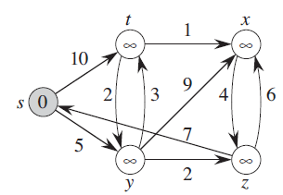
Dijkstra’s Algorithm - example
S=S U {u} | Q {s t x y z} | {u}
{} | {0 ∞ ∞ ∞ ∞}
|Q|=5

Slide 28
Dijkstra’s Algorithm - example
S=S U {u} | Q {s t x y z} | {u}
{} | {0 ∞ ∞ ∞ ∞} | {s}
|Q|=5

Slide 29
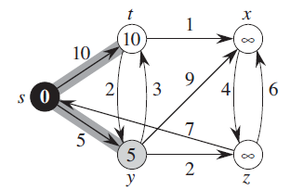
Dijkstra’s Algorithm - example
S=S U {u} | Q {s t x y z} | {u}
{} | {0 ∞ ∞ ∞ ∞} | {s}
{s} | {0 10 ∞ 5 ∞}
|Q|=4

Slide 30
Dijkstra’s Algorithm - example
S=S U {u} | Q {s t x y z} | {u}
{} | {0 ∞ ∞ ∞ ∞} | {s}
{s} | {0 10 ∞ 5 ∞} | {y}
|Q|=4

Slide 31
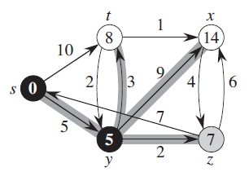
Dijkstra’s Algorithm - example
S=S U {u} | Q {s t x y z} | {u}
{} | {0 ∞ ∞ ∞ ∞} | {s}
{s} | {0 10 ∞ 5 ∞} | {y}
{s, y} | {0 8 14 5 7}
|Q|=3

Slide 32
Dijkstra’s Algorithm - example
S=S U {u} | Q {s t x y z} | {u}
{} | {0 ∞ ∞ ∞ ∞} | {s}
{s} | {0 10 ∞ 5 ∞} | {y}
{s, y} | {0 8 14 5 7} | {z}
|Q|=3

Slide 33
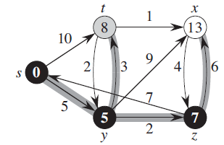
Dijkstra’s Algorithm - example
S=S U {u} | Q {s t x y z} | {u}
{} | {0 ∞ ∞ ∞ ∞} | {s}
{s} | {0 10 ∞ 5 ∞} | {y}
{s, y} | {0 8 14 5 7} | {z}
{s, y, z} | {0 8 13 5 7}
|Q|=2

Slide 34
Dijkstra’s Algorithm - example
S=S U {u} | Q {s t x y z} | {u}
{} | {0 ∞ ∞ ∞ ∞} | {s}
{s} | {0 10 ∞ 5 ∞} | {y}
{s, y} | {0 8 14 5 7} | {z}
{s, y, z} | {0 8 13 5 7} | {t}
|Q|=2

Slide 35
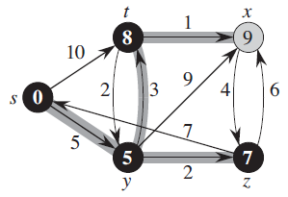
Dijkstra’s Algorithm - example
S=S U {u} | Q {s t x y z} | {u}
{} | {0 ∞ ∞ ∞ ∞} | {s}
{s} | {0 10 ∞ 5 ∞} | {y}
{s, y} | {0 8 14 5 7} | {z}
{s, y, z} | {0 8 13 5 7} | {t}
{s, y, z, t} | {0 8 9 5 7}
|Q|=1

Slide 36
Dijkstra’s Algorithm - example
S=S U {u} | Q {s t x y z} | {u}
{} | {0 ∞ ∞ ∞ ∞} | {s}
{s} | {0 10 ∞ 5 ∞} | {y}
{s, y} | {0 8 14 5 7} | {z}
{s, y, z} | {0 8 13 5 7} | {t}
{s, y, z, t} | {0 8 9 5 7} | {x}
|Q|=1

Slide 37
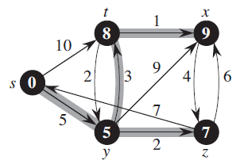
Dijkstra’s Algorithm - example
S=S U {u} | Q {s t x y z} | {u}
{} | {0 ∞ ∞ ∞ ∞} | {s}
{s} | {0 10 ∞ 5 ∞} | {y}
{s, y} | {0 8 14 5 7} | {z}
{s, y, z} | {0 8 13 5 7} | {t}
{s, y, z, t} | {0 8 9 5 7} | {x}
{s, y, z, t,x} | {0 8 9 5 7}
|Q|=0

Slide 38
Time complexity
Depends on how many times each operation takes place:
Inserts in Priority queue – V times
Extract min operation – V times
Decrease key operation(relaxation) - E times

Slide 39
Time complexity – with different data structure
With Array
(1) – insert
(V)- Extract min
(1) – decrease key
Total = V* (1) + V*(V) +E*(1)= (E) + (V²) = (V²)
Binary mean heap
(lg V) – insert
(lg V)- Extract min [deleting min is constant but resorting/updating after delete will take lg V]
(lg V) – decrease key
Total = V* (lg V) + V*(lg V) +E*(lg V)= (E lg V)
Fibonacci heap :
(1) – insert
(lg V)- Extract min
(1) – decrease key
Total = V* (1) + V*(lg V) +E*(1)= (E + V lg V)

Slide 40
Time complexity – summary
Data Structure used | Insert (V times) | Extract-min (V times) | Decrease key(E times) | Total
Array | (1) | (V) | (1) | (V²)
Binary Heap | (lg V) | (lg V) | (lg V) | (E lg V)
Fibonacci Heap | (1) | (lg V) | (1) | (E + V lg V)

Slide 41
Negative weight vs. negative cycle
If the graph G (V,E) contains no negative weight cycles reachable from the source s,
then for all vertices v  V , the shortest-path weight δ(s, v) remains well defined, even if it has a negative value.
If the graph contains a negative-weight cycle reachable from s
shortest-path weights are not well defined.

Slide 42
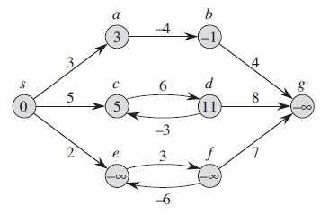
Negative weight vs. negative cycle
Path weight of e and f continues to decrease as we follow the loop.
As a result weight for g will also keep decreasing.
So, path of these 3 nodes become undefined.

Slide 43
Negative weight vs. negative cycle
On the contrary even though path to b contains a negative weight but as there is no negative cycle, b will have a defined shortest path.
Also c and d has a cycle but not negative cycle. So, they also have defined shortest path.

Slide 44
Bellman-Ford algorithm

Slide 45
Bellman-Ford algorithm
The Bellman-Ford algorithm solves the general case in which edge weights may be negative.
Given a weighted, directed Graph G(V,E ) with source s and weight function w,
It returns a boolean value indicating whether or not there is a negative-weight cycle that is reachable from the source.
If there is such a cycle, the algorithm indicates that no solution exists.
If there is no such cycle, the algorithm produces the shortest paths and their weights.
The algorithm returns TRUE if and only if the graph contains no negative-weight cycles that are reachable from the source.

Slide 46
Bellman-Ford algorithm
At each iteration, at least one vertex reachable from s will have the shortest path.
So, after V-1 iteration all V-1 vertices will have their shortest path
If we can farther reduce the cost then there is a cycle

Slide 47
Bellman-Ford algorithm - Example
Process edges in following order.
5-6
4-6
4-3
2-3
1-2
1-4
1-5
-2
2
3
3
2
1
7
4
6
5
5
6
4

Slide 48
Bellman-Ford algorithm - Example
Process edges in following order.
3-4
2-3
1-3
2
1
7
5
3
4
-2

Slide 49
Bellman-Ford algorithm - Example
Process edges in following order.
3-4
2-3
1-3
2
1
7
-6
5
3
4
-2

Slide 50
Try at home
Increase all weights by a fixed number.
How to convert single source Shortest Path to a Single Destination Shortest path algorithm.
Apply Dijkstra to a graph with negative weight/cycle.

Slide 51
Reference
Chapter 24 (Cormen) -> 24.1, 24.3

